Slide 1

Dr. Akbas
Joseph Alesandrini
Sarah Gleixner
Olivia Meholic
Troy Neubauer
Nicolas Rodriguez
Jeremiah Webb

Slide 2
Overview
A public website that will enable users to filter through a database of cybersecurity tools depending on their needs (commercial, personal, etc.) and generate a report summarizing all recommended tools

Slide 3
Last Semester Progress
Website
Report Generation
Login
Design

Slide 4
Current Status
Filtering
Account Information
Forgot Password with Authentication
Continuous Integration

Slide 5

Team Member Roles
FrontEnd – Sarah, Olivia, Nicolas
Design
Login
Authentication
BackEnd – Jeremiah, Troy, Jospeh
Api
Filtering
AWS
Database

Slide 6
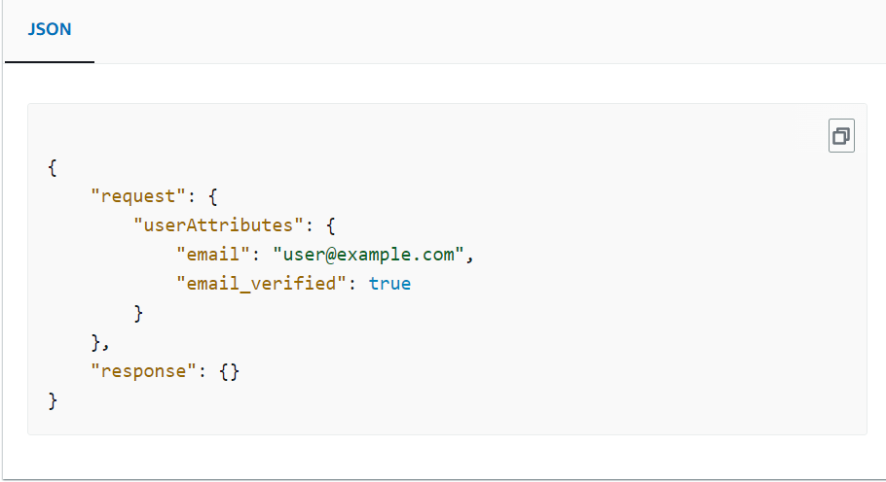
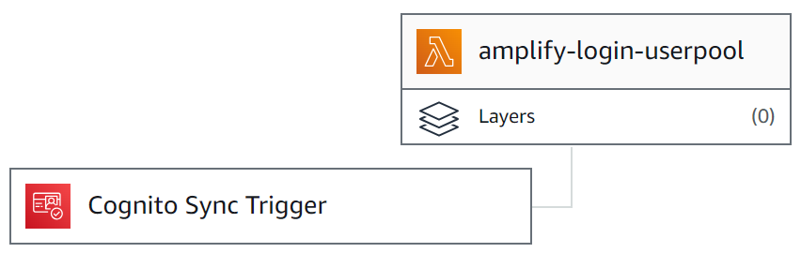
User Roles
Permission Access
Amplify triggers
Nodejs

Slide 7
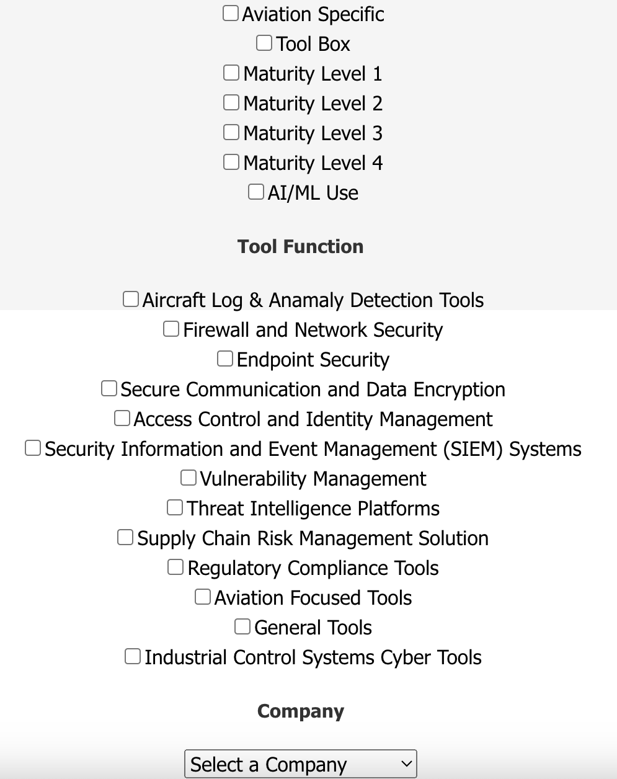
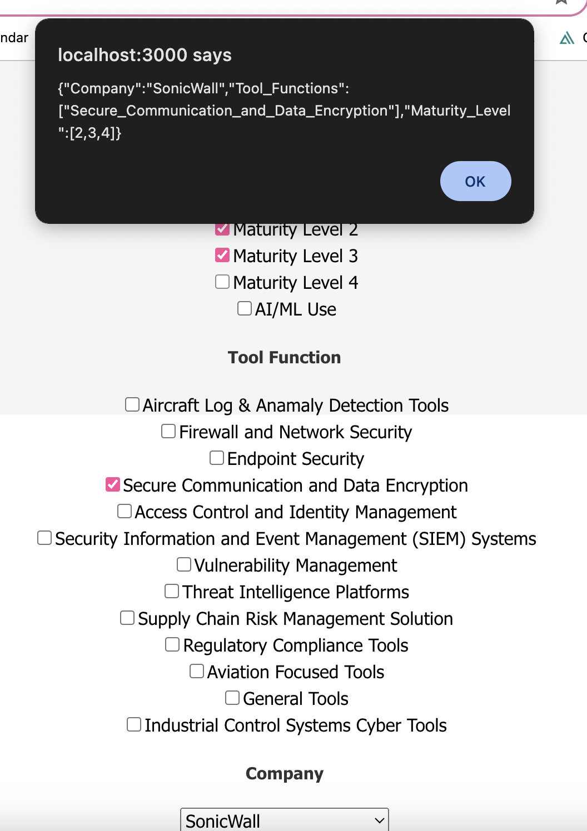
Filtering
Frontend:
Added checkboxes to allow users more than one filter choice
Added a dropdown filter option for the different company options
Converted these user inputs to JSON to send to backend. Every time a user clicks on a new filter option, the JSON object updates.

Slide 8


Backend
Filtering
Fetch Dashboard
Handling user input from React Components
Had issues with DynamoDB Attribute Types
Based on Boto3 AWS API
Ability to Paginate in DyanmoDB
Forward, but not backward!

Slide 9
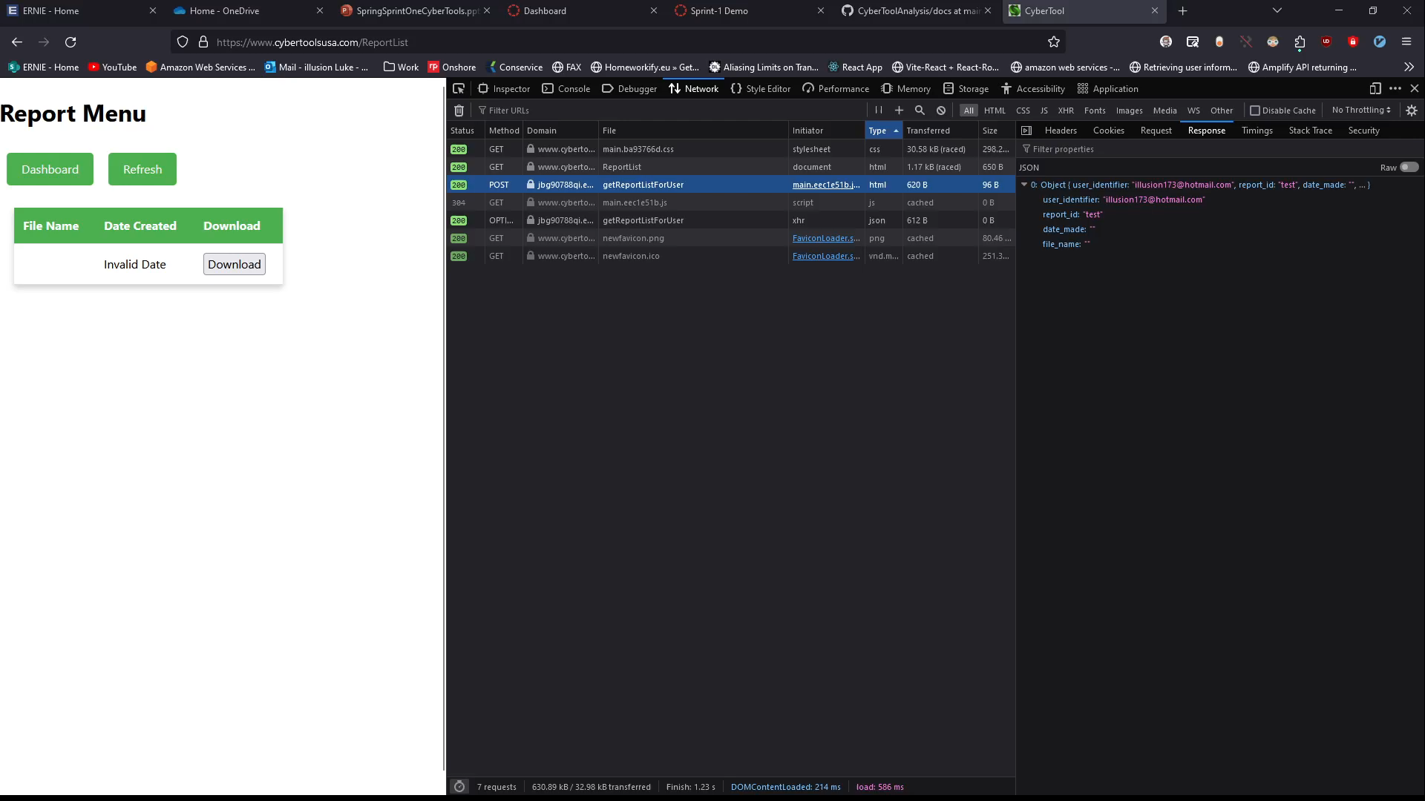
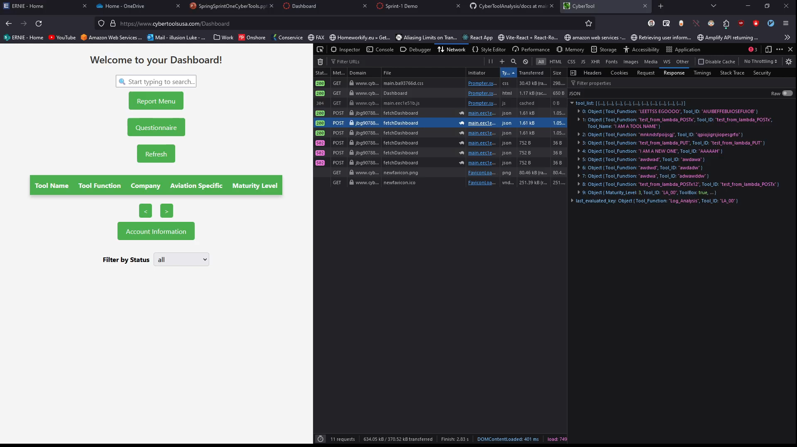
Backend - Demo
Report List -> DONE!
Presigned URL Integration -> DONE!
Fetch Dashboard -> Implemented for NO Filter
Filter Integration (Backend Done) -> Front End Implementation for Next Sprint

Slide 10
Next Sprint | Backend
Connect API Gateway endpoints to React Components
Get Singular Tool Data Done
Report creation API needs cleanup due to new database attributes
Recommendation Algorithm -> Weighing System?
Ability to add new tools to database, review method

Slide 11
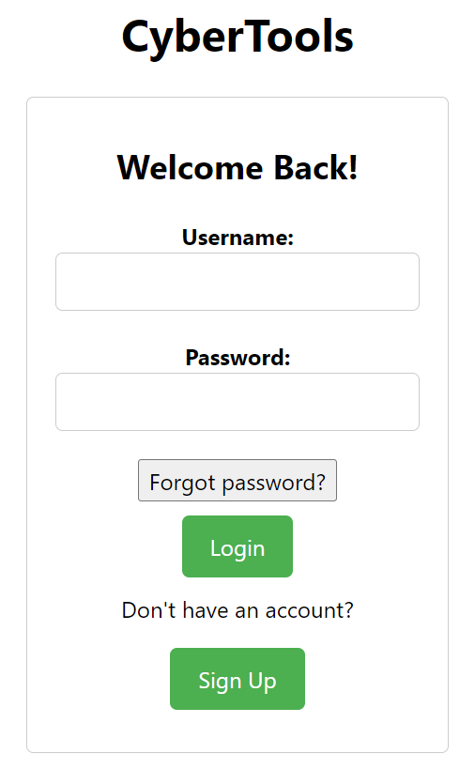
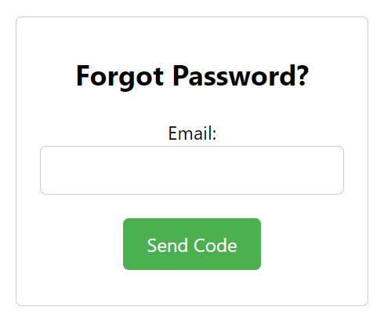
Forgot Password Functionality

Slide 12
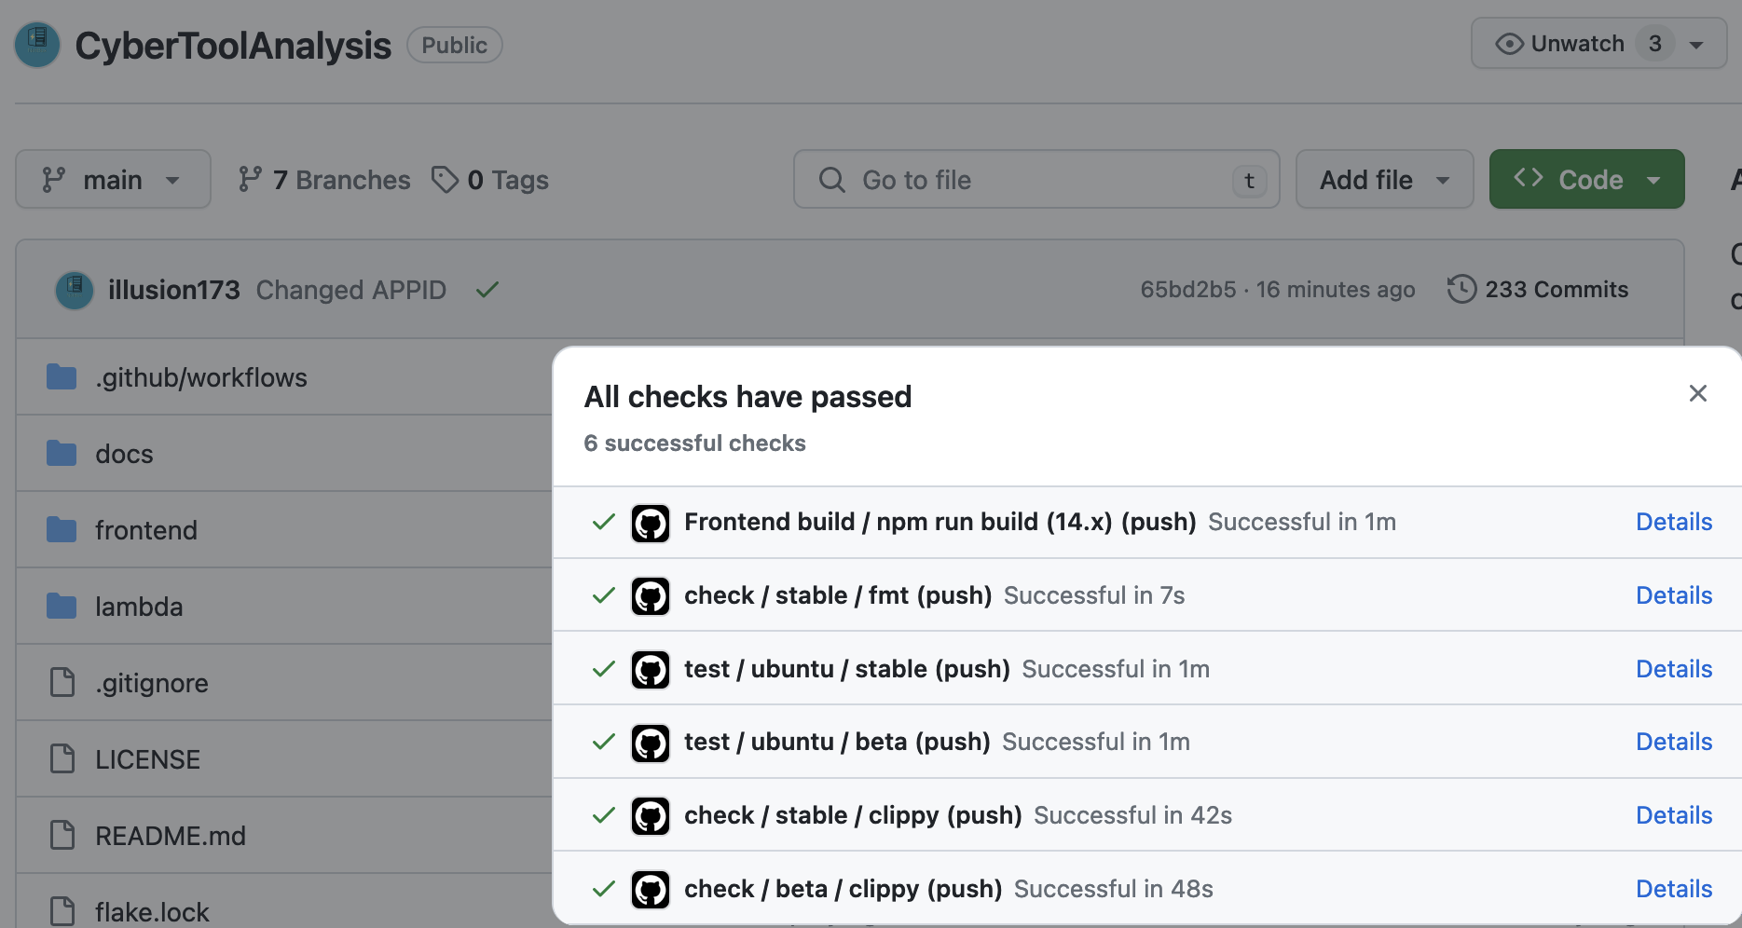
Continuous Integration
Why?
Check our work automatically
Higher developer velocity and reduced stress
Compile and run tests for both frontend and backend

Slide 13
General Cleanup
Flatten directory hierarchy
Run Clippy in CI to ensure Rust best practices are being followed
Run npm test in CI
Correct gitignore usage, prevent amplify build errors before they happen

Slide 14

Preview of Next Sprint
Filtering ready
Reset Password Page
Singular Tool Data Page
More tools

Slide 15
Demo

